Slide 1
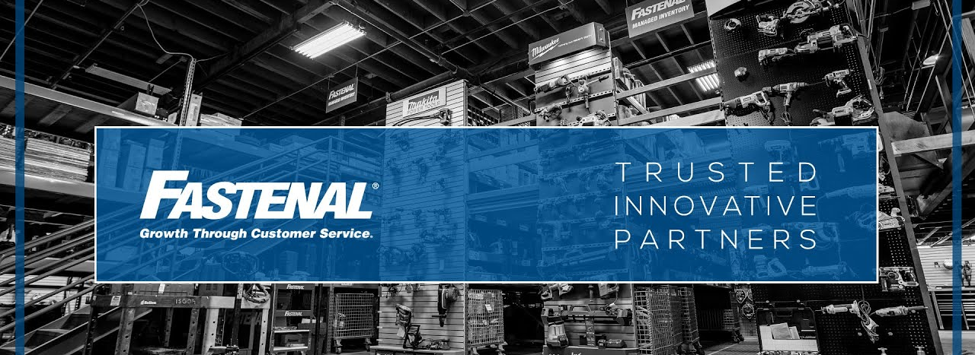
Redesigning Business Model

Slide 2


Presentation Agenda
Fastenal Company Business Problem
Marketing Recommendations
Analysis Process & Findings
Marketing Action Plan

Slide 3
Fastenal Business Model Problem
Fastenal has not identified its core customer segment and therefore have wasted marketing resources on other groups that are not as important.
Fastenal has not defined a structured method of charging for freight.

Slide 4
Marketing Recommendations
Core customer group defined on the following criteria:
Being in the top 25% of sales within manufacturing, construction, or retail.
Standard for charging freight:
Charging freight charge to non-core customers only
Implementing these rules will overall decrease wasting marketing resources towards customers not in our core segment.
Our marketing recommendations for Fastenal consist of defining their core customer segment and a standard for charging for freight.

Slide 5
Analysis Process & Findings

Slide 6
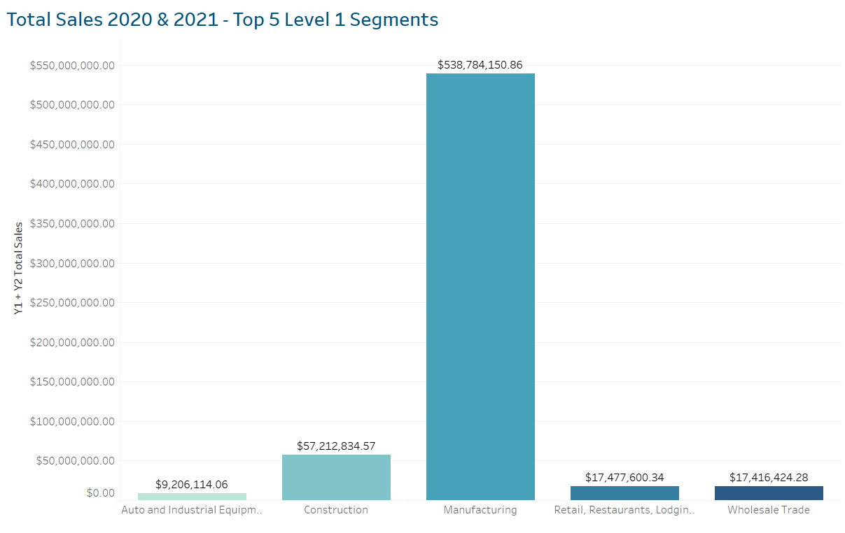
Top Customer Segments
Identified the top sales segments as Manufacturing, Construction, Retail, Wholesale Trade, and Auto and Industrial Equipment based on the marketing code level 1.

Slide 7
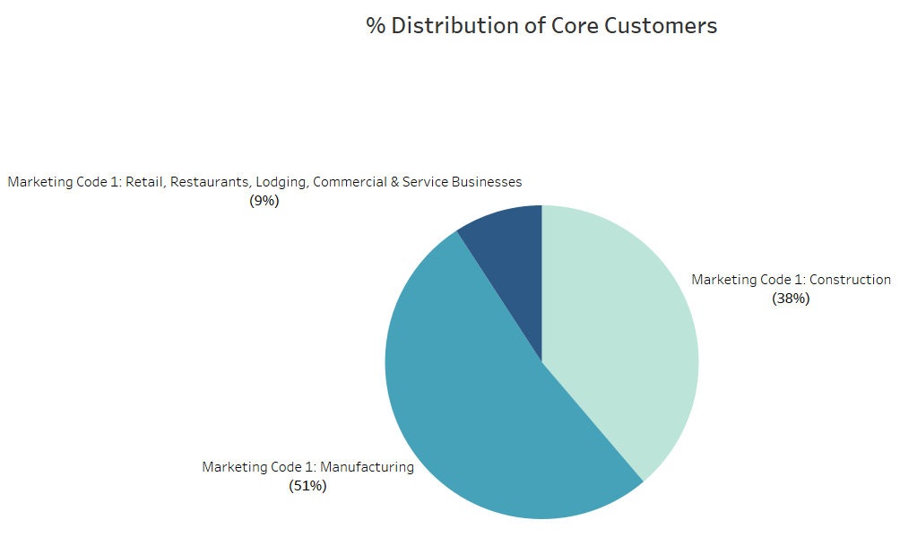
Core Customer Segment Group (2021)
Defined as:
Top 25% of customers based on the top 3 marketing code categories
Manufacturing
Construction
Retail
9% of total customer base
Fastenal’s core customer group is :
9% of customers within Retail, Restaurants, Lodging, Commercial & Service Business
35% of customer within construction
51% of customers within manufacturing

Slide 8
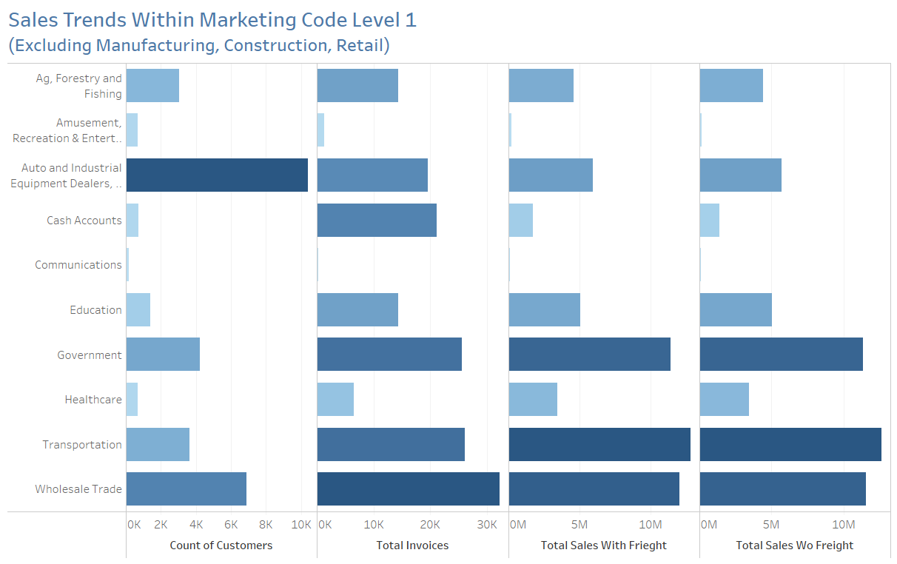
Sales Trends within Marketing Code Level 1
We removed the top 3 categories of Manufacturing, Construction, and Retail in order to look for areas of improvement.
Invest more resources in government, transportation, and wholesale trade
We have low count of customers, yet high invoices and sales

Slide 9
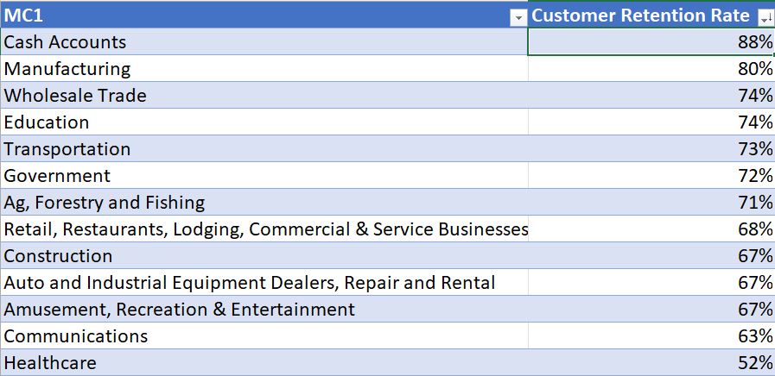
Customer Retention Rate Based on Marketing Code
Year 2021 retention rate for the marketing codes level 1
Cash accounts, manufacturing, wholesale trade were the top 3 based on returning customer sales

Slide 10
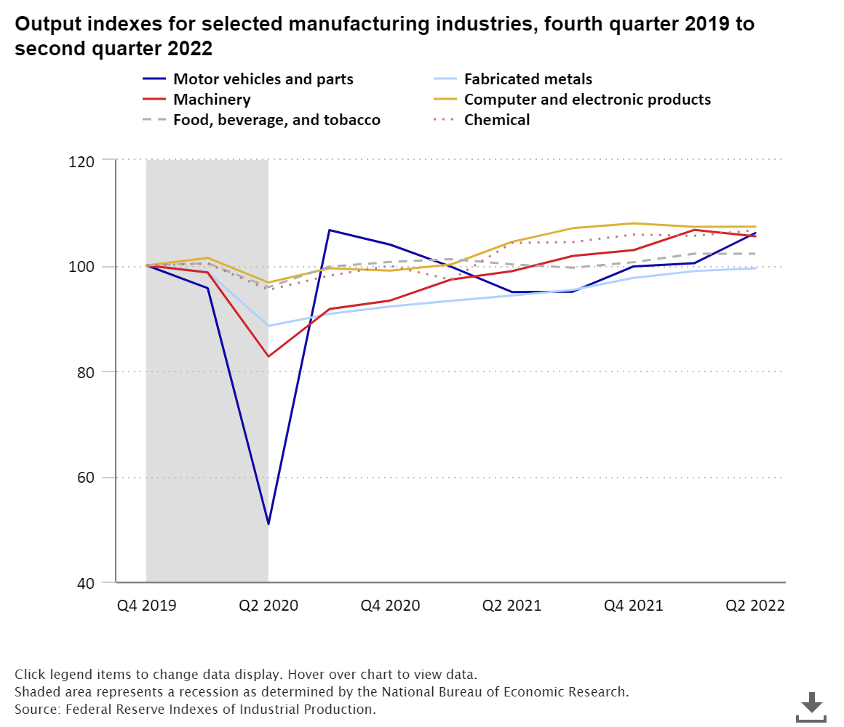
COVID-19 Economic Trends in Manufacturing in U.S.
After the COVID-19 pandemic began, manufacturing output fell at a 43-percent annual rate and hours worked fell at a 38-percent rate in the second quarter of 2020.[2]
Motor Vehicles and parts got most affected. It declined over the next three quarters due to supply chain disruptions.
Manufacturing productivity increased more than 9 percent in the second quarter of 2021, the quarter with the largest decline in hours worked since the second quarter of 2020.

Slide 11
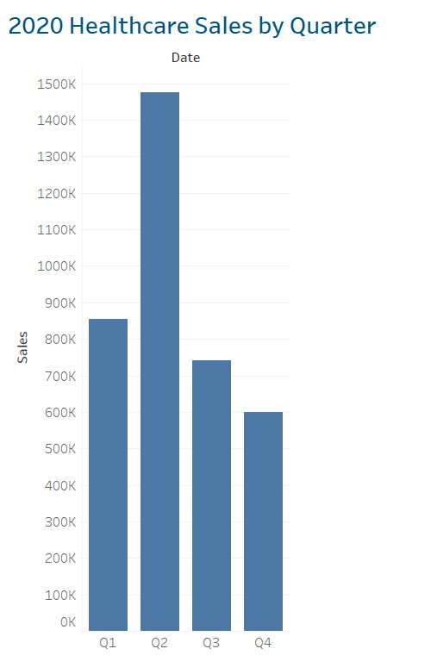
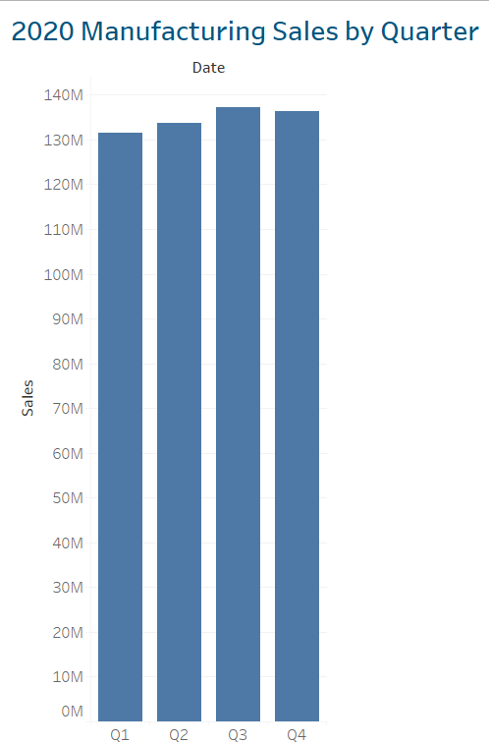
Fastenal COVID-19 Trends
In the year of 2020, total sales increased from Q1-Q2
COVID-19 did not drastically affect Fastenal sales
Supply chain disruptions, changes in demand for products, shifts in consumer behavior

Slide 12
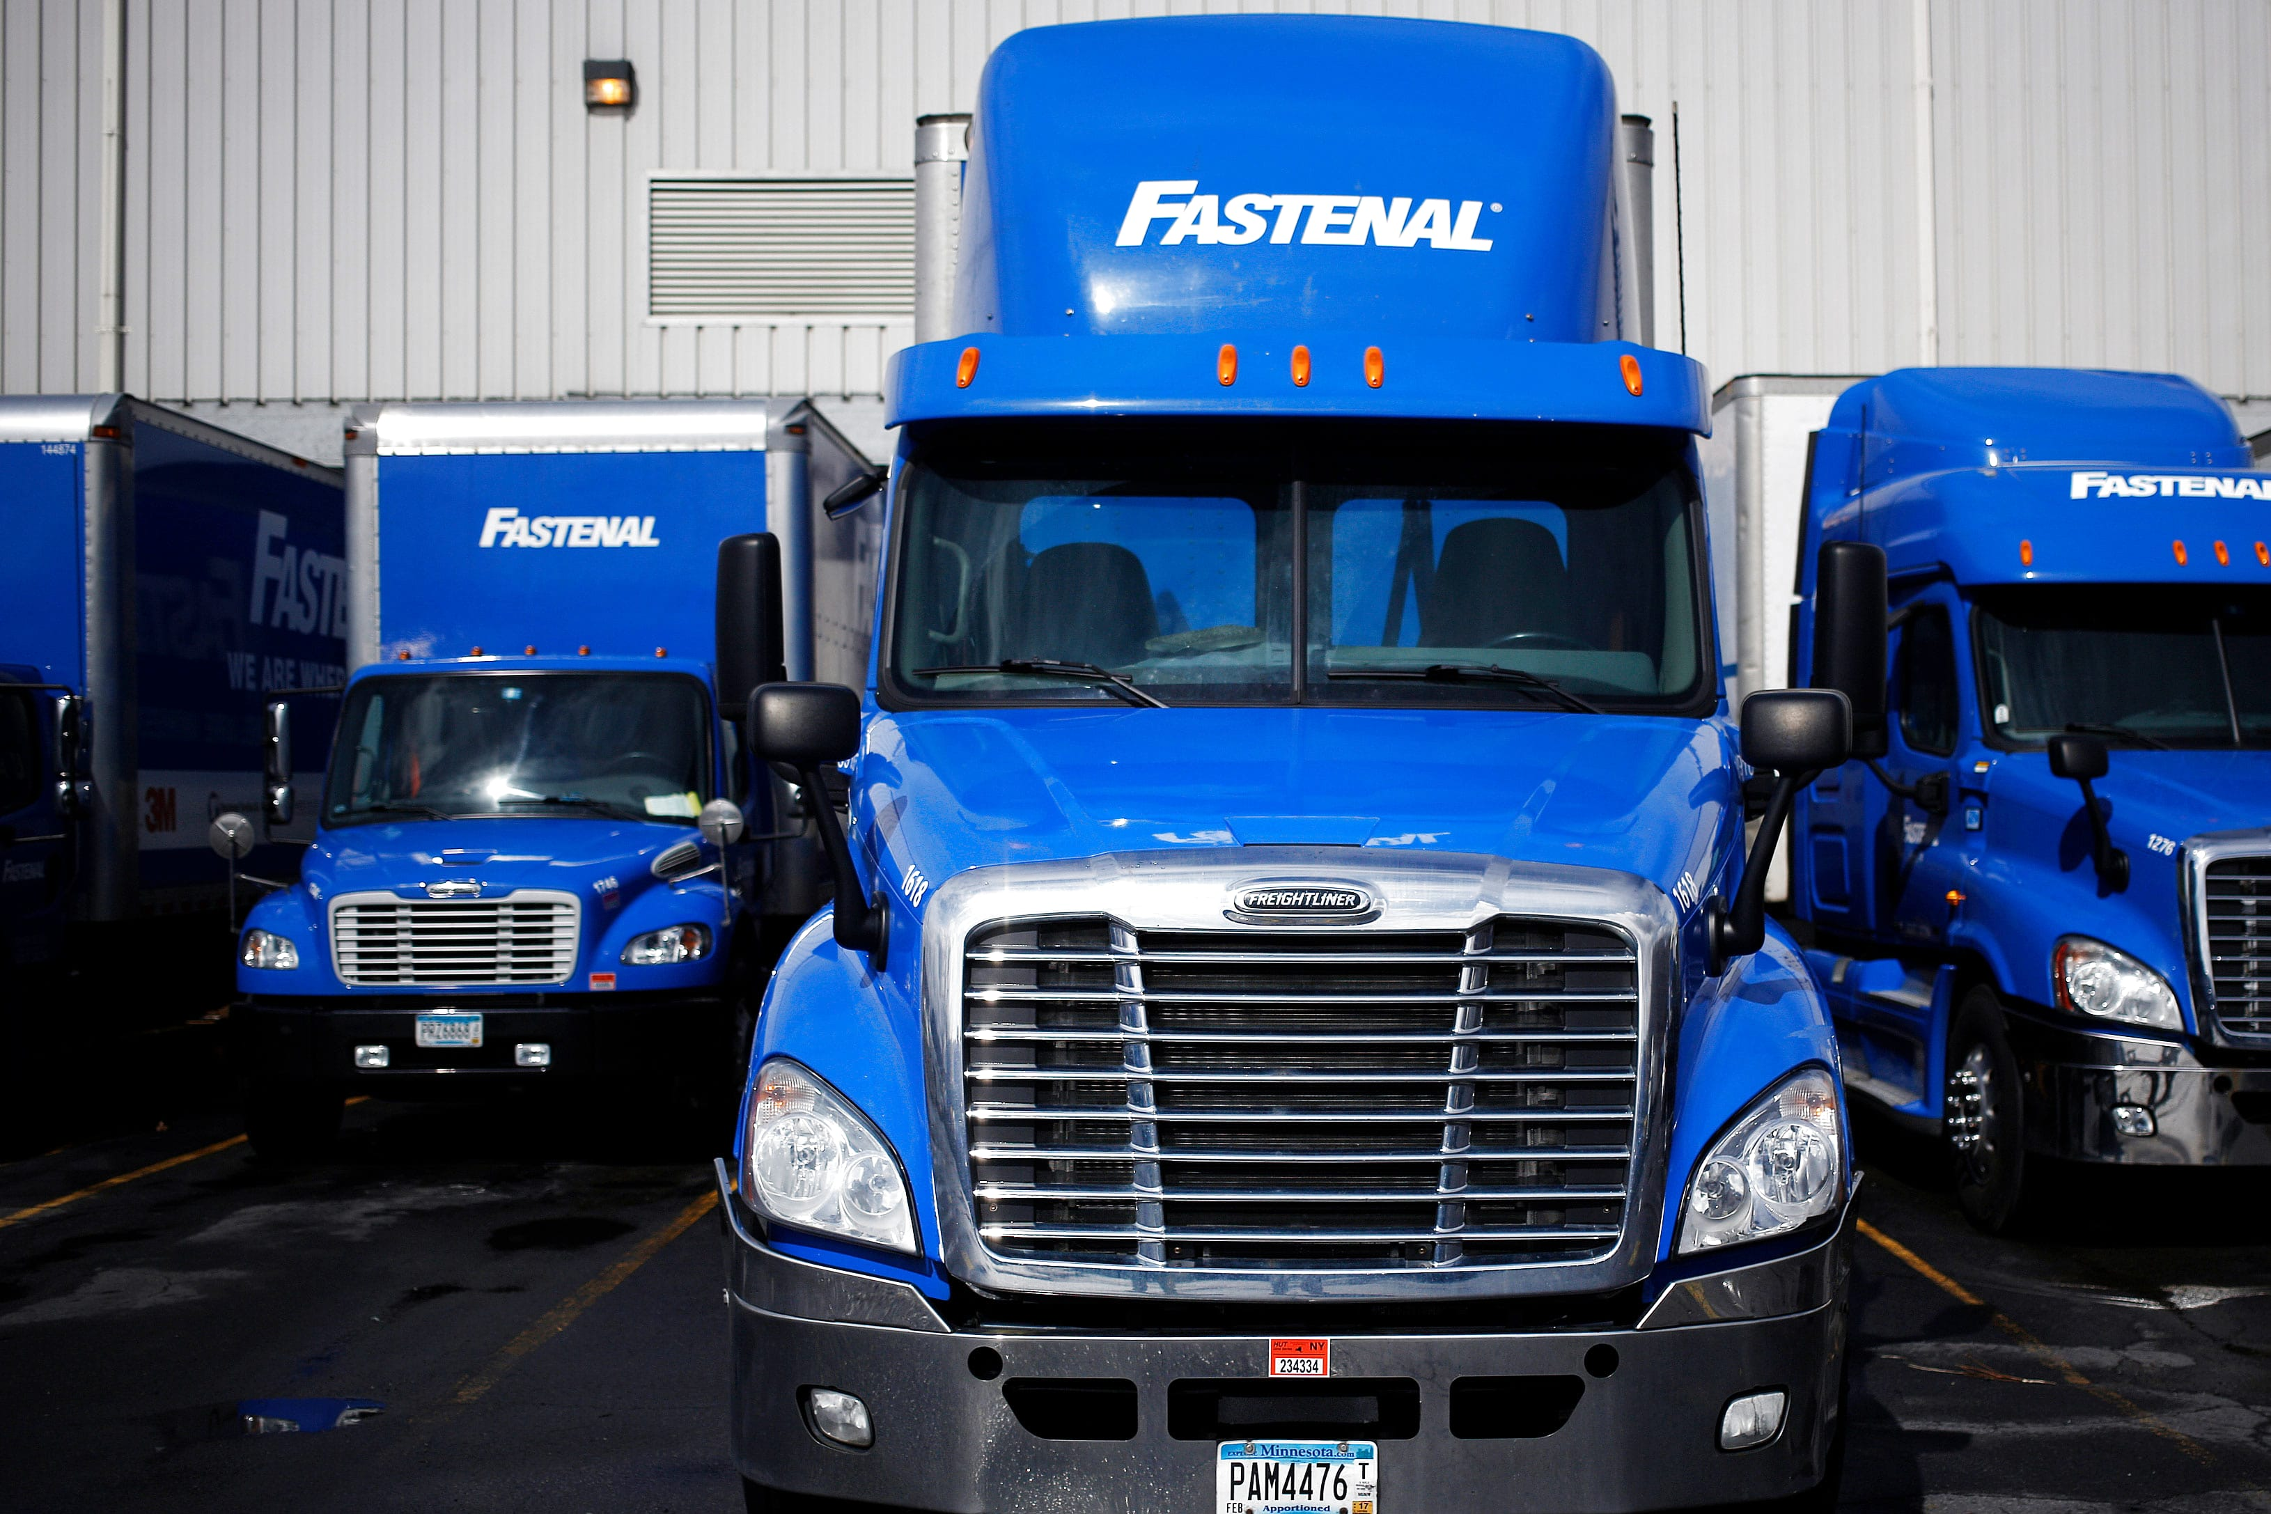
Fastenal Marketing Action Plan
Fastenal should eliminate freight cost for their core customer segment
Fastenal should focus direct marketing towards new customers in core industries
Fastenal should incorporate dynamic customer segmenting each year
Fastenal should invest resources in government, transportation and wholesale trade

